Slide 1

CS4225/CS5425 Big Data Systems for Data Science
Logistics + Introduction
Bryan Hooi
School of Computing
National University of Singapore
bhooi@comp.nus.edu.sg
Notes:
Note: all notes in this and future pptx files are not considered to be part of the required course content, and will not appear on tests. (They are just my notes or for background knowledge).

Slide 2
Schedule
Week | Date | Topics | Tutorial | Due Dates
1 | 18 Aug | Overview and Introduction
2 | 25 Aug | MapReduce - Introduction
3 | 1 Sep | Polling Day Public Holiday
4 | 8 Sep | MapReduce and Databases | Tutorial: MapReduce | Assignment 1 released
5 | 15 Sep | NoSQL Overview 1
6 | 22 Sep | NoSQL Overview 2 | Tutorial: NoSQL
Recess
7 | 6 Oct | Apache Spark 1
8 | 13 Oct | Apache Spark 2 | Tutorial: Spark | Assignment 1 due (15 Oct 11.59pm), Assignment 2 released
9 | 20 Oct | Stream Processing 1
10 | 27 Oct | Stream Processing 2 | Tutorial: Stream Processing
11 | 3 Nov | Large Graph Processing 1
12 | 10 Nov | NUS Well-Being Day
13 | 17 Nov | Large Graph Processing 2 | Tutorial: Graph Processing | Assignment 2 due (19 Nov 11.59pm)
 | 29 Nov | Final Exam

Slide 3
Assessment
2 assignments on Hadoop and Spark (25% each)
Final exam (50%) – held in-person.
(Note: no weightage for in-lecture-quizzes)

Slide 4
Tutorials
Start from Week 4
Not counted for final grade
Tutorial questions will be available on Canvas before the tutorial: we recommend attempting questions before tutorial
Some questions are samples for tests
Notes:
All tutorial questions are available in LumiNUS.
You are encouraged to attend the tutorial. Tutors will give explanations to the questions in details. Attending the tutorial can help you to understand the key concepts in this course.
Also, it will be good if you attempt questions before the tutorial. Also, some questions can be viewed as samples for tests.

Slide 5
Final Exam
Date: 29 Nov
Held in class; open book + notes, but no electronics usage
Focus is on understanding and application, not facts / memorization
Example questions
Integrative: Require you to combine knowledge from different chapters of the textbook
Application: Require you to apply your knowledge of fundamental concepts to reasonably practical scenarios.
“Why not”: Example: Tommy proposed a solution A to solve problem B. Explain the problem with solution A and how to overcome this problem
Notes:
We have a test of about 1 hour.
You can find the example questions in tutorials. Basically, questions will be like 3 categories. We question you about the understanding of concepts and techniques, rather than memorizing the terms word by word.
Integrative: Require you to combine knowledge from different chapters of the textbook. The question will cover different chapters.
Application: Test how well you can apply your knowledge to a practical scenario.
“Why not”: Example, Tommy proposed a solution A to solve problem B in the lecture. Tell me what is the problem with solution A and how to overcome this problem.

Slide 6
What will we learn?
We will learn to process different types of data:
Large data volume
Graph data
Stream data (infinite/never-ending)
We will learn to use different models of computation:
MapReduce/Spark
Large graph processing engines
Streams and online algorithms
Notes:
In more details… about this course.

Slide 7
What is Data Science?
Standard definition:
“Data science is an interdisciplinary field about processes and systems to extract knowledge or insights from data in various forms.”

Slide 8
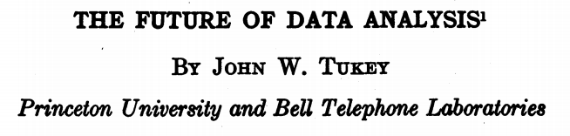
What is Data Science?
Standard definition:
“Data science is an interdisciplinary field about processes and systems to extract knowledge or insights from data in various forms.”
Historical view: in 1962, statistician John Tukey described a field called “data analysis”, which emerged out of statistics, but focusing not just on testing hypotheses, but on computing aspects of data analysis: including collecting, storing, analyzing, presenting data, etc.
Early transistor computers (TX-0, IBM 608, 7000 series)
Early DBMS,
statistical software
COBOL
1950
UNIVAC I
1957
1960
1962

Slide 9
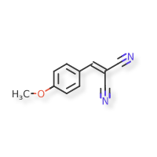

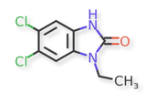
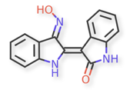

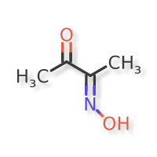


Q: What rule characterizes toxic molecules?
Toxic
Non-toxic
Toxic
Non-toxic
Notes:
These are real molecules (but the rule doesn't generalize well)

Slide 10
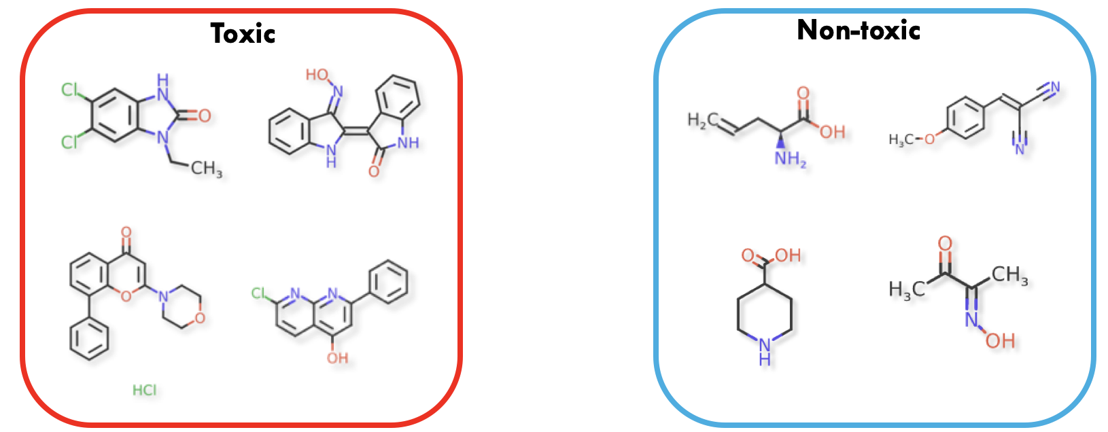
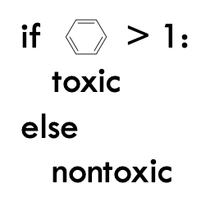

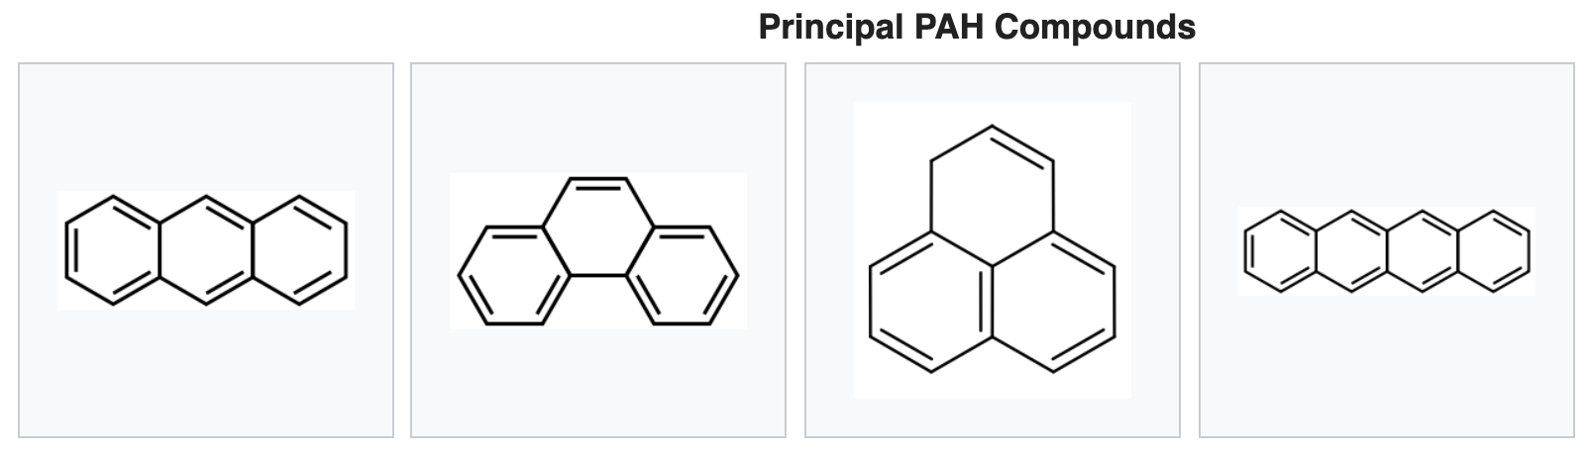
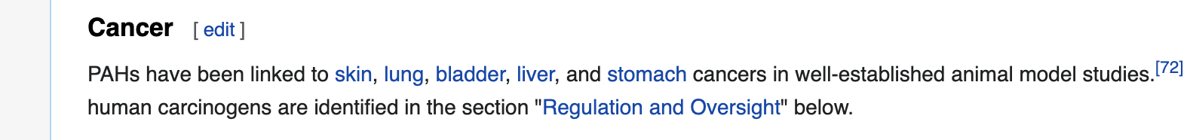
Q: What rule characterizes toxic molecules?

Slide 11
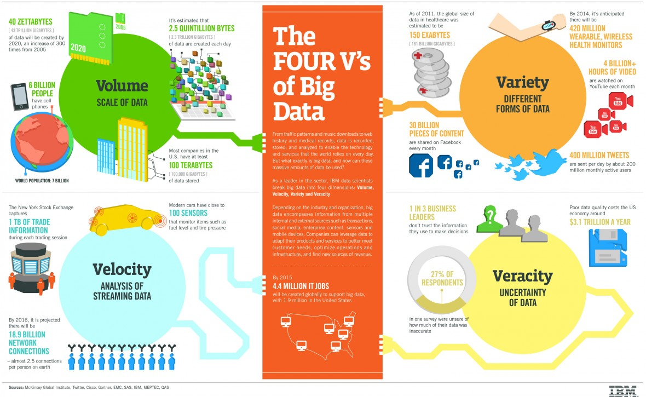
Challenges of Big Data: the 4 ‘V’s
Notes:
http://www.ibmbigdatahub.com/infographic/four-vs-big-data

Slide 12
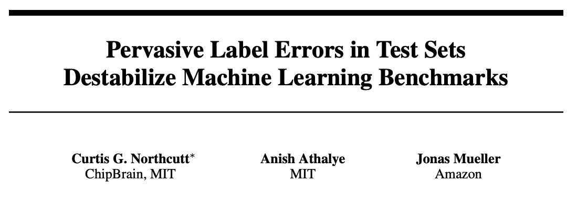
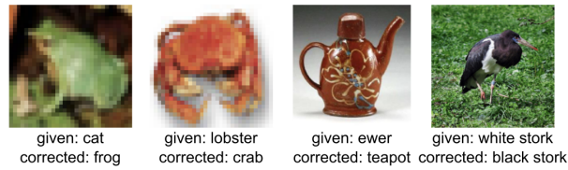
Veracity: ~3.3% of data in some of the most popular datasets are mislabelled
[1] Northcutt, Curtis G., Anish Athalye, and Jonas Mueller. "Pervasive Label Errors in Test Sets Destabilize Machine Learning Benchmarks." NeurIPS 2021

Slide 13
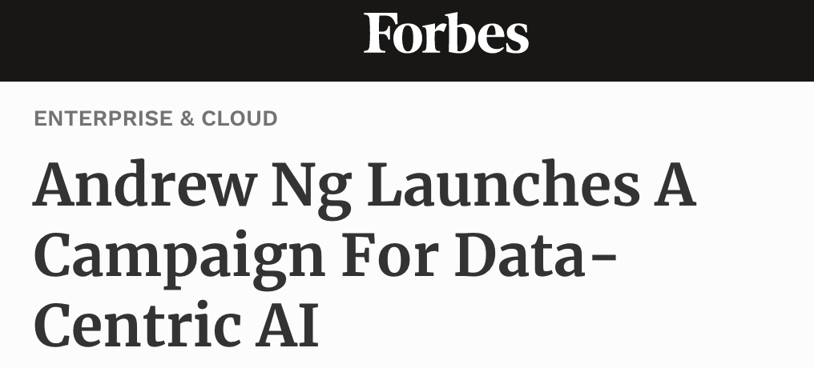
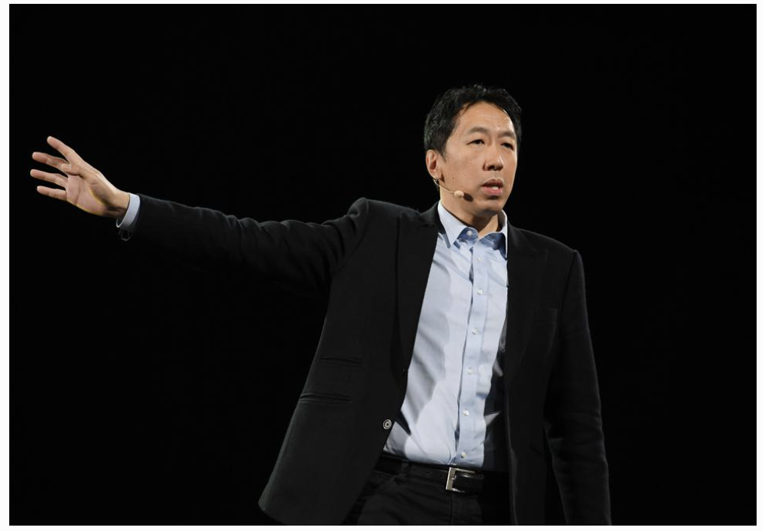
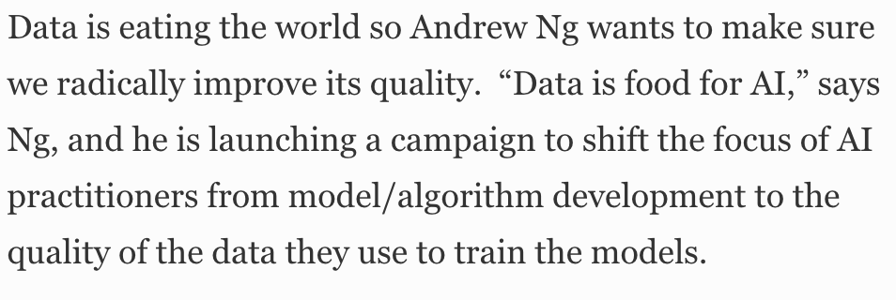
Veracity: Importance of Data Quality

Slide 14

Infrastructure: Cloud Computing
Source: Wikipedia (Clouds)
Notes:
The major infrastructure is cloud computing.

Slide 15
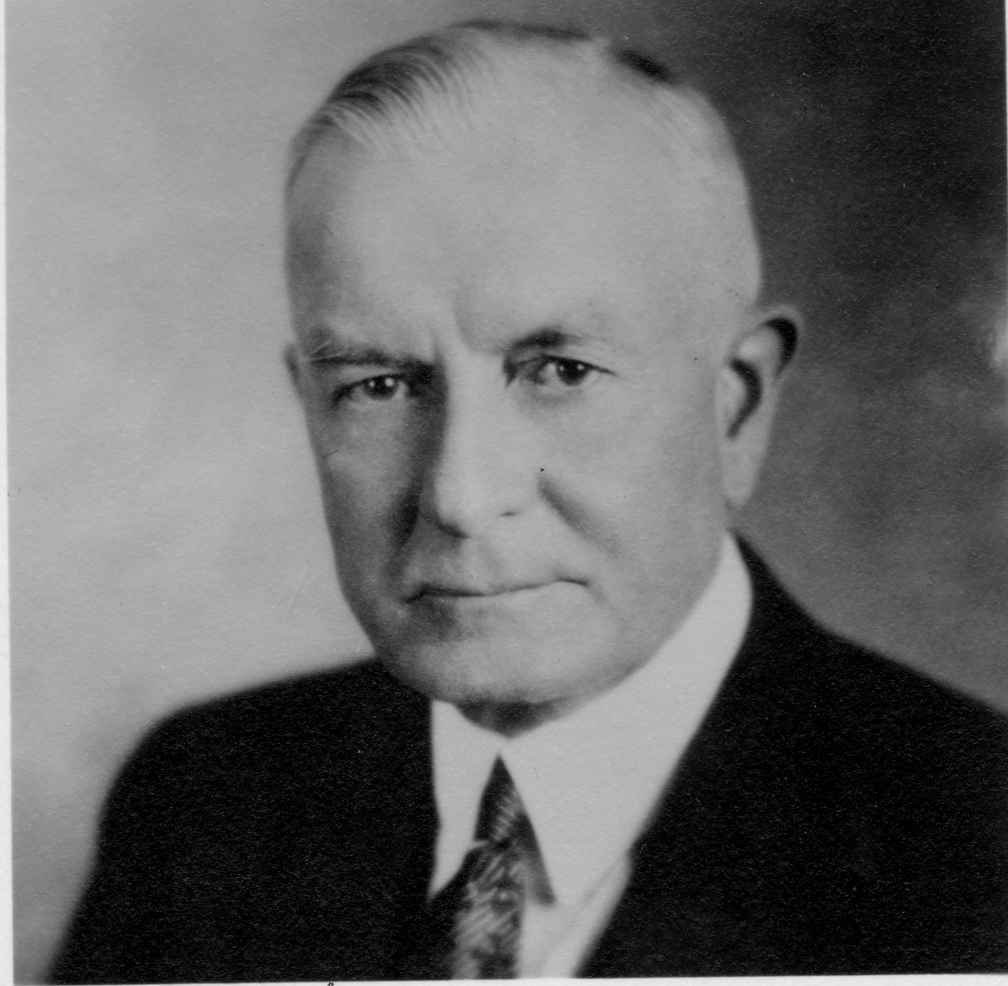
Utility Computing
What?
Computing resources as a metered service (“pay as you go”)
Ability to dynamically provision virtual machines
Why?
Scalability: “infinite” capacity
Elasticity: scale up or down on demand
I think there is a world market for about five computers.
Thomas J. Watson (attributed?)
(all
Notes:
Utility: water, electricity… you pay according to the metered. Thus, it is pay as you go.
The other reason is that, if we assume that the cloud has sufficient resources, it enables us to dynamically provision VMs. (→elastic).
Why utility computing is good?
Cost: we do not need to pay the capital on hardware investment. We do not need to buy physical servers, or build our own data centers. Rather, we only need to pay the cost of using the VM.
Scalability: ideally we can have sufficient resources considering a data centers can have tens of thousands of machines.
Elasticity: our workload usually flatuates along the time too.
In recent years of cloud computing development, it seems a win-win solution for users and provider.
Thomas J. Watson of I.B.M. is said to have opined in 1943 that, “I think there is a world market for about five computers.”

Slide 16
Enabling Technology: Virtualization and Containers
App
App
App
App
App
App
OS
OS
Bin/libs
Bin/libs
Operating System
Hypervisor
Operating System
Hardware
Hardware
Hardware
Traditional Stack
Virtual Machines (VMs)
Containers
Virtual Machines: enable sharing of hardware resources by running each application in an isolated virtual machine.
High overhead as each VM has its own OS.
Containers: enable lightweight sharing of resources, as applications run in an isolated way, but still share the same OS.
A container is a lightweight software package that encapsulates an application and its environment.
Notes:
The enabling technologies is virtualization. We can run multiple virtual machines on the same hardware. Therefore, it is more cost effective and flexible.
https://en.wikipedia.org/wiki/Virtualization
Container is the new trend.

Slide 17
Everything as a Service
Infrastructure as a Service (IaaS): Utility Computing
Why buy machines when you can rent cycles?
Examples: Amazon’s EC2, Rackspace, Google Compute Engine
Platform as a Service (PaaS)
Provides hosting for web applications and takes care of the hardware maintenance, upgrades, …
Example: Google App Engine
Software as a Service (SaaS)
Just run it for me!
Example: Gmail, Dropbox, Zoom
Notes:
The concept of service is very important for cloud computing, which is not only a business model, but also give high flexibility and benefits.
IaaS
PaaS
SaaS
No mater whether you are aware or not, we are in the cloud.
Also cloud providers now tend to offer all levels of services: IaaS, PaaS, SaaS.

Slide 18
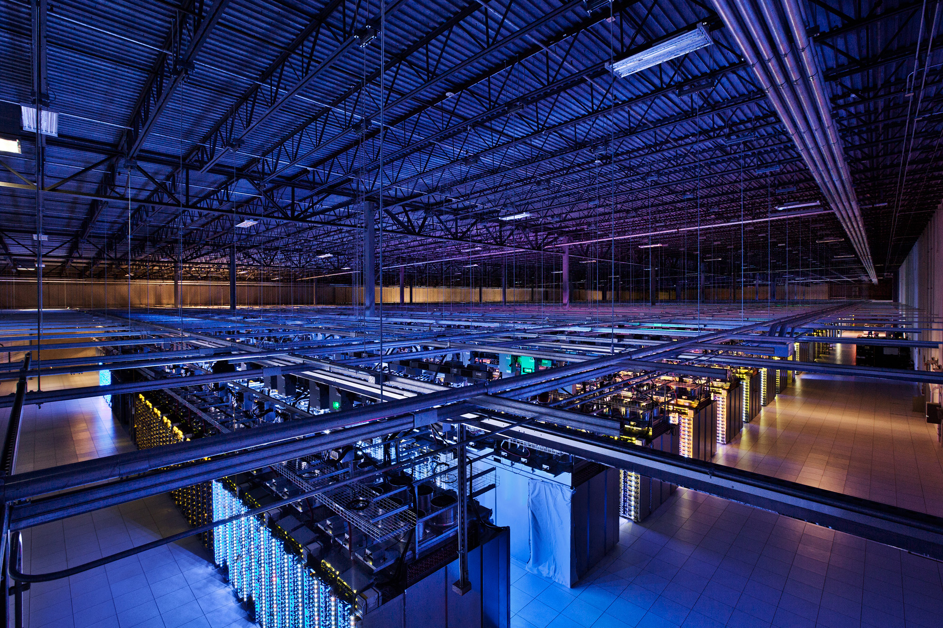
Infrastructure: Data Centers
Source: Google
Notes:
This is a figure from a real data center (google). You can see other facilities like cooling etc.

Slide 19
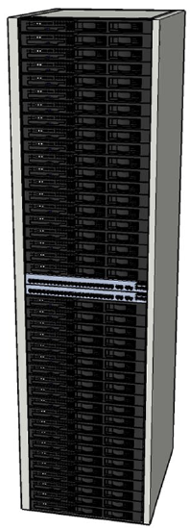
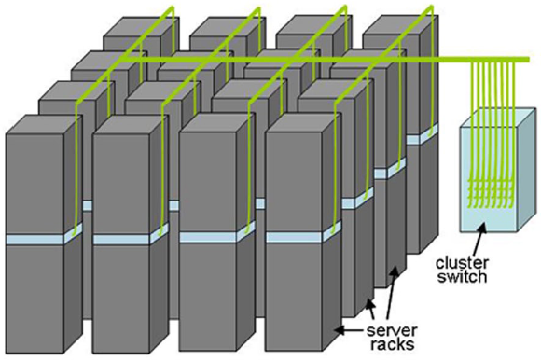

Building Blocks
Source: Barroso and Urs Hölzle (2009)
Notes:
A blade server (commodity hardware)
A rack consists of dozens of servers.
A data centers contains of hundreds of or more racks.

Slide 20
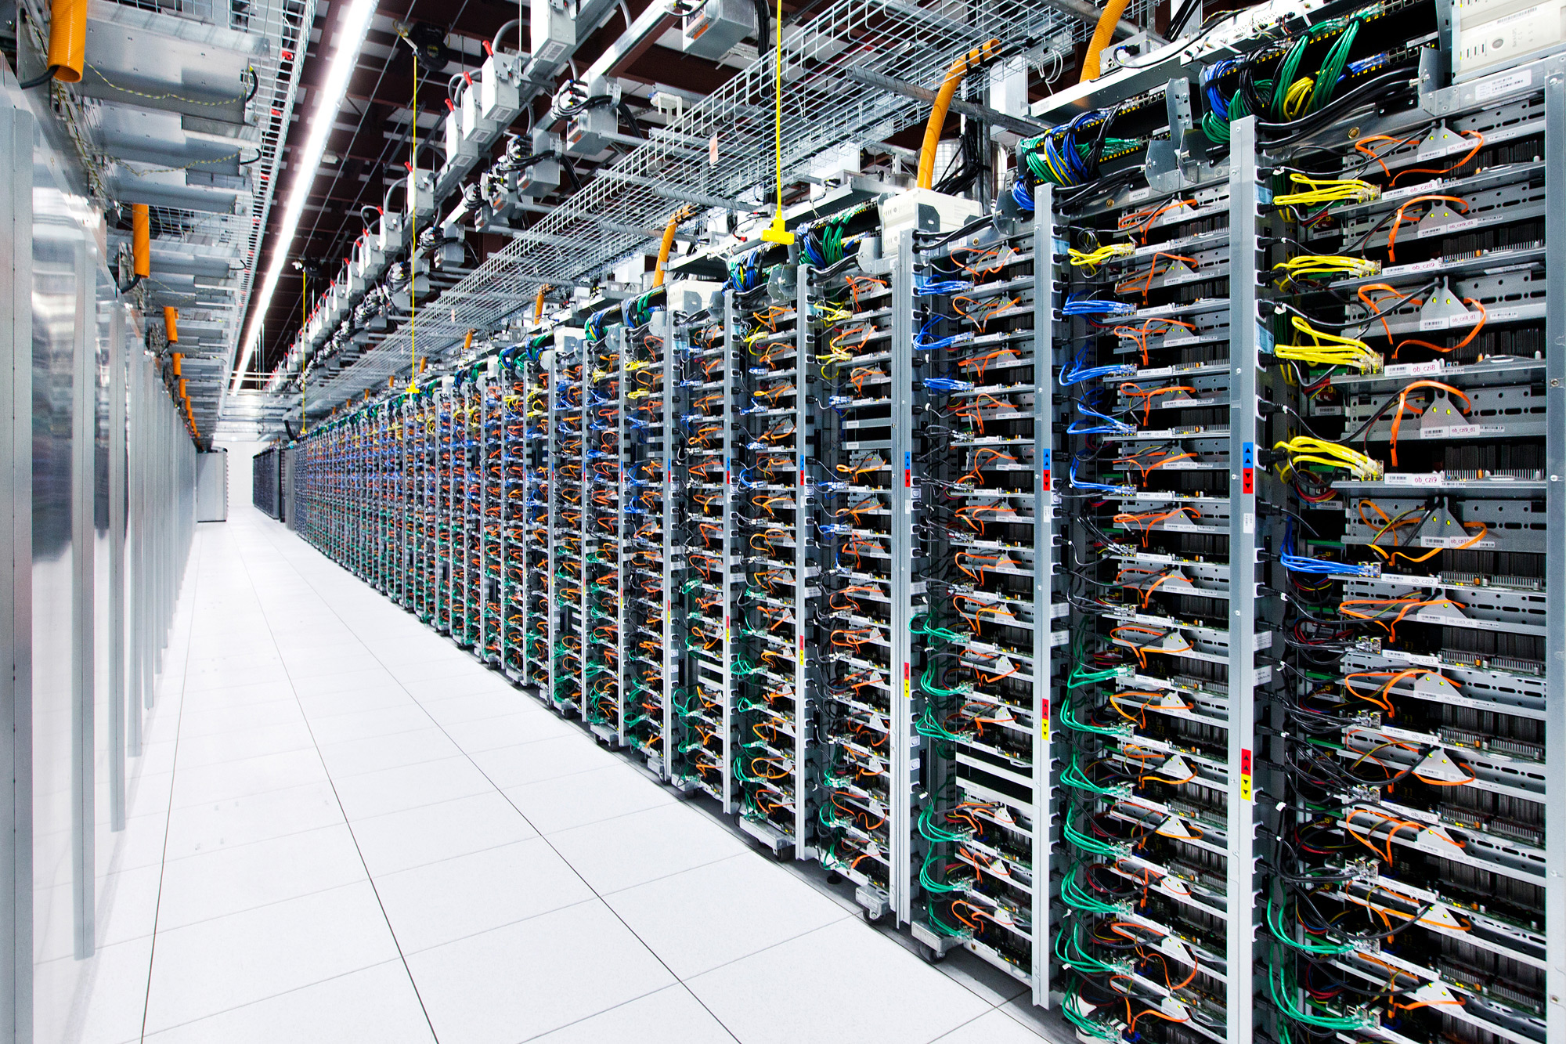
Source: Google

Slide 21
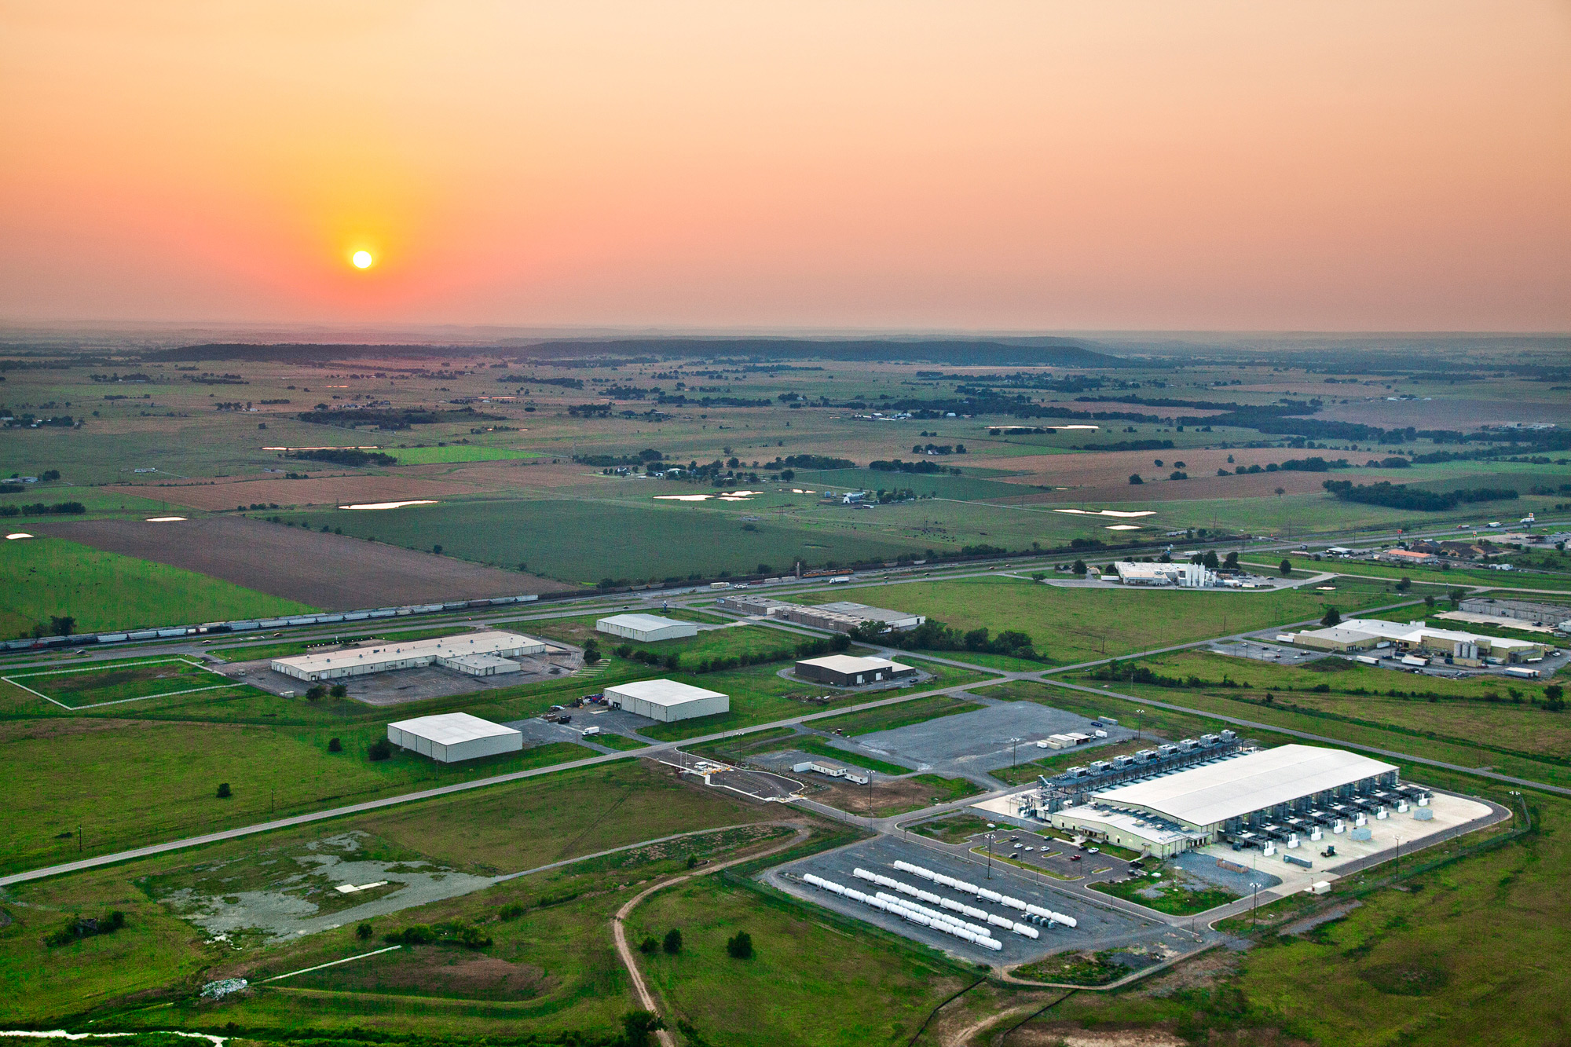
Key Idea: the datacenter is the computer
(Meaning: we can think of the machines in a data center as a big “processing unit” being used to solve a problem, rather than just as independent machines)
Source: Google
Notes:
Data center is a key infrastructure for big data. We will revisit the data center infrastructure briefly. Again, you should be able to learn in more depth in other courses.

Slide 22
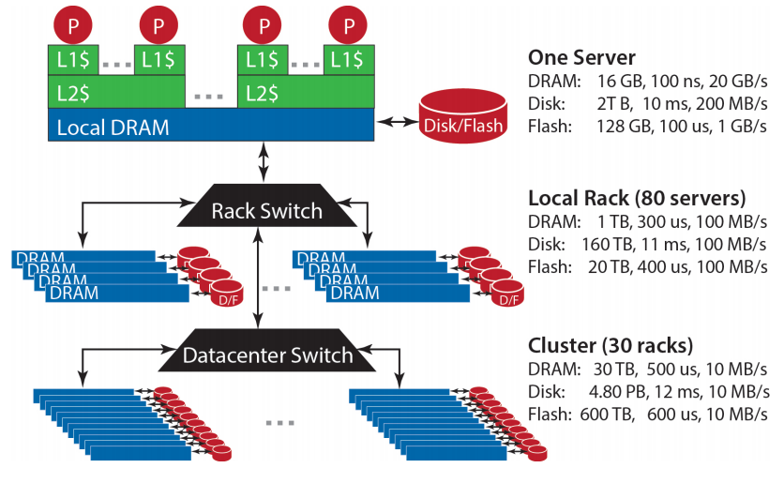
Storage Hierarchy
Source: Barroso and Urs Hölzle (2013)
Notes:
Storage hierarchy is important for big data storage and processing. This is corresponding to the hierarchy of server, rack and data center.
On a single server
On a local rack
On a cluster
Do you observer some interesting features on the performance, capacity of the storage hierarchy?

Slide 23
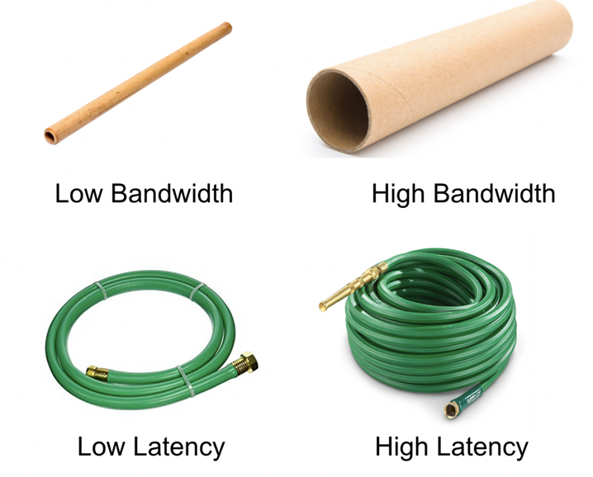
Bandwidth vs Latency
Bandwidth: maximum amount of data that can be transmitted per unit time (e.g. in GB/s)
Latency: time taken for 1 packet to go from source to destination (one-way) or from source to destination back to source (round trip), e.g. in ms
When transmitting a large amount of data, bandwidth tells us roughly how long the transmission will take.
When transmitting a very small amount of data, latency tells us how much delay there will be.
Throughput is similar to bandwidth, but instead of referring to capacity, it refers to the rate at which some data was actually transmitted across the network during some period of time.
Adding many lanes to a highway: increases bandwidth, but does not decrease latency
Credit: Katie Hempenius (via Jake Archibald)

Slide 24
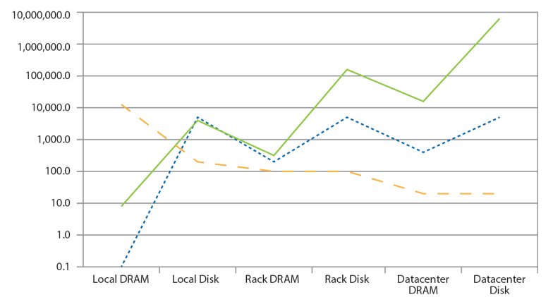
Capacity of Storage Hierarchy
Capacity (GB)
Latency (µs)
Bandwidth (GB)
1. Disk has much higher capacity than DRAM
Source: Barroso and Urs Hölzle (2013)
Notes:
Moving data around data center is costly! Pay attention the y-axis is at the log scale.
Capacity: DRAM<Disk. The comparison between local disk and rack DRAM can change now… we have terabytes of memory machines. But in general, this comparison is true.
Latency: Disk latency is always much slower than DRAM.
The DRAM in the data center scale can be over 1000 times slower than the local DRAM.
Bandwidth: network is the bound (bottleneck). That is why we see a decreasing trend.

Slide 25
Capacity of Storage Hierarchy
Local
Rack
Data Center
Capacity (GB)
Latency (µs)
Bandwidth (GB)
2. Storage hierarchy: capacity increases as we go from Local Server, to Rack, to Datacenter.
Source: Barroso and Urs Hölzle (2013)
Notes:
Moving data around data center is costly! Pay attention the y-axis is at the log scale.
Capacity: DRAM<Disk. The comparison between local disk and rack DRAM can change now… we have terabytes of memory machines. But in general, this comparison is true.
Latency: Disk latency is always much slower than DRAM.
The DRAM in the data center scale can be over 1000 times slower than the local DRAM.
Bandwidth: network is the bound (bottleneck). That is why we see a decreasing trend.

Slide 26
Speed of Moving Data Around Data Center
Capacity (GB)
Latency (µs)
Bandwidth (GB)
3. Disk reads are much more expensive than DRAM, both in terms of with higher latency and lower bandwidth.
Source: Barroso and Urs Hölzle (2013)
Notes:
Moving data around data center is costly! Pay attention the y-axis is at the log scale.
Capacity: DRAM<Disk. The comparison between local disk and rack DRAM can change now… we have terabytes of memory machines. But in general, this comparison is true.
Latency: Disk latency is always much slower than DRAM.
The DRAM in the data center scale can be over 1000 times slower than the local DRAM.
Bandwidth: network is the bound (bottleneck). That is why we see a decreasing trend.

Slide 27
Speed of Moving Data Around Data Center
Local
Rack
Data Center
Capacity (GB)
Latency (µs)
Bandwidth (GB)
4. Costs increase over the storage hierarchy: latency increases as we go from Local to Rack to Datacenter.
Source: Barroso and Urs Hölzle (2013)
Notes:
Moving data around data center is costly! Pay attention the y-axis is at the log scale.
Capacity: DRAM<Disk. The comparison between local disk and rack DRAM can change now… we have terabytes of memory machines. But in general, this comparison is true.
Latency: Disk latency is always much slower than DRAM.
The DRAM in the data center scale can be over 1000 times slower than the local DRAM.
Bandwidth: network is the bound (bottleneck). That is why we see a decreasing trend.

Slide 28
Speed of Moving Data Around Data Center
Local
Rack
Data Center
Capacity (GB)
Latency (µs)
Bandwidth (GB)
5. Costs increase over the storage hierarchy: bandwidth decreases as we go from Local to Rack to Datacenter.
Source: Barroso and Urs Hölzle (2013)
Notes:
Moving data around data center is costly! Pay attention the y-axis is at the log scale.
Capacity: DRAM<Disk. The comparison between local disk and rack DRAM can change now… we have terabytes of memory machines. But in general, this comparison is true.
Latency: Disk latency is always much slower than DRAM.
The DRAM in the data center scale can be over 1000 times slower than the local DRAM.
Bandwidth: network is the bound (bottleneck). That is why we see a decreasing trend.

Slide 29
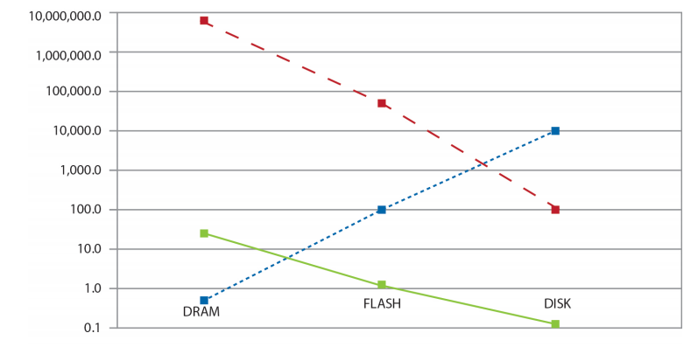
Price vs Speed Tradeoff
Latency (µs)
Speed (Ops/sec)
Price ($/GB)
DRAM: fast but most expensive
DISK: slow but cheapest
Source: Barroso and Urs Hölzle (2013)
Notes:
Throughput: ops/sec.
Within a single server. Latency: Disk>flash>DRAM. Throughput: Disk<flash<DRAM. Cost per GB: DRAM>Flash>disk.
There is a tradeoff.

Slide 30
“Big Ideas” of Massive Data Processing in Data Centers
Scale “out”, not “up”
scale ‘out’ = combining many cheaper machines; scale ‘up’: increasing the power of each individual machine
Also called ’horizontal’ vs ‘vertical’ scaling
Move processing to the data
Clusters have limited bandwidth: we should move the task to the machine where the data is stored
Process data sequentially, avoid random access
Seeks are expensive, disk throughput is reasonable
Seamless scalability
E.g. if processing a certain dataset takes 100 machine hours, ideal scalability is to use a cluster of 10 machines to do it in about 10 hours.
Notes:
From the architecture, we can see a few “big ideas” or principles in data processing in data centers.
It favors scale-out, rather than scale-up. Scale-up means we increase the capability of a single machine. Scale-out is trying to use many machines and aggregate the power to do one thing.
Move the data is costly. Thus move processing to task.
Process data sequentially, rather random accesses. Random accesses in hard disk is unacceptable.
We should offer good engineered systems for good scalability.
The Mythical Man-Month: Essays on Software Engineering is a book on software engineering and project management by Fred Brooks, whose central theme is that "adding manpower to a late software project makes it later". This idea is known as Brooks' law, and is presented along with the second-system effect and advocacy of prototyping.
We introduce the idea of the “tradeable machine hour”, as a play on Brook’s classic title. If running an algorithm on a particular dataset takes 100 machine hours, then we should be able to finish in an hour on a cluster of 100 machines, or use a cluster of 10 machines to complete the same task in ten hours.13 With MapReduce, this isn’t so far from the truth, at least for some applications.

Slide 31

Q: What type of application domains are you most interested in?
Business
Scientific
Biomedicine
Engineering
Finance / Economics
Web / E-commerce
Education
Other

Slide 32
MapReduce
Motivation
Basic MapReduce
Source: Google
Notes:
Recall we are doing big data on data center or cluster.

Slide 33
Motivation: Google Example
20+ billion web pages: ~400+ TB
1 computer reads 30-35 MB/sec from disk
~4 months to read the web
~1,000 hard drives to store the web
Takes even more to do something useful with the data!
Infrastructure: cloud + data centers
Cluster of commodity nodes
Commodity network (ethernet) to connect them
Solution:
Parallelization + divide and conquer
Notes:
Let’s start with a concrete example from google. Google have indexed 20+ billion web pages (now actually it is more than that…)
You can check: http://www.worldwidewebsize.com/. Now it is around 60+ billion web pages.
Anyway, let’s use 20+ billion as the example. Each page with 20KB (considering only text…. Without images/video etc). Thus, we have 400 TB. If we use a single computer, how long will it take to read the entire set of pages? Over 4 months!
How many disks do we need? Around 1000 disks.
Given this, cloud and data centers are a must. Recall, data centers consists of commodity nodes (not supercomputer!), and they are connected by Ethernet switches.
In order to attempt the 400TB with a reasonable time limit, we definitely need parallelization. Basically, we use divide and conquer methodology.

Slide 34
Divide and Conquer
“Work”
Partition
w₁
w₂
w₃
worker
worker
worker
r₁
r₂
r₃
Combine
“Result”
Notes:
This is an ideal processing scenario of divide and conquer. We divide the “work” (400 TB of pages) into a number of smaller works (w1, w2, w3..). Each worker will handle a piece of work, and generate some partial results (r1, r2, …). Finally, we need to combine the partial results to get the final result for users.
Why I said it is an ideal scenario?

Slide 35
Challenges
How do we assign work units to workers?
What if we have more work units than workers?
What if workers need to share partial results?
How do we aggregate partial results?
How do we know all the workers have finished?
What if workers die/fail?
Notes:
How to assign work units?
We want to assign balanced loads, but hard to know how to balance!
What if worker finishes early? Can we assign more tasks?
How do we know if all finished?
Poll workers – problem: slow
Ask workers to notify you when done – problem: what if don’t receive a response? Can use heartbeat, but what if workers are just very slow?

Slide 36
Challenge 1: Machine Failures
One server may stay up 10 years (~3650 days)
If you have 3650 servers, expect to loose 1/day
People estimated Google had ~2.5 million machines in 2016
~700 machines fail every day!
Notes:
Let’s make a simple example for machine failures…
Suppose One server may stay up 3 years (1,000 days).
If you have 1,000 servers, expect to loose 1/day. You can apply some kind of calculation called Weibull.
http://www.weibull.com/hotwire/issue94/relbasics94.htm
People estimated Google had ~1M machines in 2011
1,000 machines fail every day!
Machine failures can cause a lot of difficult issues for big data systems… for example, a) how do we know the machine is failed? Maybe, it is just slow… b)how can we save the partial results? How can we restart the failed task without a lot of progress loss?
Many research efforts have been done, and still more efforts are being paid to this complicated problem.

Slide 37
Challenge 2: Synchronization
Difficult because
We don’t know the order in which workers run
We don’t know when workers interrupt each other
We don’t know when workers need to communicate partial results
We don’t know the order in which workers access shared data
Thus, we need control mechanisms, such as barriers
Notes:
https://en.wikipedia.org/wiki/Sleeping_barber_problem
https://en.wikipedia.org/wiki/Cigarette_smokers_problem
In data center, managing a large number of workers is difficult…
We don’t know the order in which workers run
We don’t know when workers interrupt each other
We don’t know when workers need to communicate partial results
We don’t know the order in which workers access shared data
Now, can we use some “classic” techniques to address them?
Yes, we learn those in OS and parallel course: semaphores, barriers etc… but still, there are many issues.
Deadlock, livelock, race conditions...
Dining philosophers, sleeping barbers, cigarette smokers...
We need to handle them in a massive scale of data center. Ooops… we need to be careful…

Slide 38

Barrier
Simple tool used when multiple processes are running at the same time
It ensures that every process must stop at this point until all processes have reached the barrier

Slide 39
Challenge 3: Programming Difficulty
Concurrency is difficult to reason about
At the scale of datacenters and across datacenters
In the presence of failures
In terms of multiple interacting services
Not to mention debugging…
The reality:
Lots of one-off solutions, custom code
Write you own dedicated library, then program with it
Burden on the programmer to explicitly manage everything
Notes:
Parallelism and concurrency are inherently difficult…
Even more difficult in our cases (at the scale of data centers, machine failures, and interacting services)…
You may wonder what MPI is good for? MPI is designed for run on reliable but expensive hardware (supercomputers). Many scientific applications are regular (workers have little communications).
How can we debug for big data?? ☹
So in fact, if we stay with the current tools, we may end up with very bad situations in terms of software maintanence.
Lots of one-off solutions, custom code
Write you own dedicated library, then program with it
Burden on the programmer to explicitly manage everything

Slide 40
The datacenter is the computer
It’s all about the right level of abstraction
Moving beyond the single machine architecture
What’s the “instruction set” (or “API”) of the datacenter computer?
Hide system-level details from the developers
No more race conditions, lock contention, etc.
No need to explicitly worry about reliability, fault tolerance, etc.
Separating the what from the how
Developer specifies the computation that needs to be performed
Execution framework (“runtime”) handles actual execution
Notes:
Ideally, what we need is a right level of abstraction. What are the building blocks (instruction set) of the data center?
Hide system-level details from the developers
No more race conditions, lock contention, etc.
No need to explicitly worry about reliability, fault tolerance, etc.
Separating the what from the how
Developer specifies the computation that needs to be performed
Execution framework (“runtime”) handles actual execution
With such a runtime, developers can focus on their big data services, rather than worrying about the underlying infrastructures.
Also, for performance optimizations, we allow the optimizations on the four big ideas.

Slide 41
MapReduce
Motivation
Basic MapReduce
Source: Google
Notes:
Recall we are doing big data on data center or cluster.

Slide 42
Typical Big Data Problem
Iterate over a large number of records
Extract something of interest from each
Shuffle and sort intermediate results
Aggregate intermediate results
Generate final output
Map
Shuffle
Reduce
Key idea: provide a functional abstraction for these two operations
(Dean and Ghemawat, OSDI 2004)
Notes:
As we see in the divide-and-conquer scenario, this is a typical big data processing problem.
Step 1: Iterate over a large number of records
Step 2: Extract something of interest from each
Step 3: Shuffle and sort intermediate results
Step 4: Aggregate intermediate results
Step 5: Generate final output
Yeah, actually, big data processing has some patterns. Google (or jeff dean) identified the pattern as two functional abstractions. Map, and Reduce.
Map is to extract something of interest from each chunk of data. Users can implement the logic on how to extract.
Reduce is to aggregate the intermediate results. Users can implement the logic on how to combine.
Other steps are rather standard and common for different processing tasks.
https://research.google.com/pubs/jeff.html

Slide 43
Basic Example: Tabulating Election Results from Multiple Polling Sites
Imagine you are hired to develop the software for Singapore’s election counting system.
You need to aggregate vote counts from multiple stations into the final counts.
Party A
Party B
Party A
Party B
Party B
Party A
Party A
Party A
Party A

Slide 44
Basic Example: Tabulating Election Results from Multiple Polling Sites
Imagine you are hired to develop the software for Singapore’s election counting system.
You need to aggregate vote counts from multiple stations into the final counts.
Party A
Party B
Party A
Party A: 6
Party B: 3
Party A
Party B
Party B
Party A
Party A
Party A

Slide 45
Tabulating Election Results: MapReduce
Map
Reduce
Shuffle
Party A
Party B
Party A
Party A
Party B
Party B
Party A: 6
Party B: 3
Party A
Party A
Party A
Notes:
Let’s see how we break down the election counting task into small steps (map, shuffle, reduce)

Slide 46
Tabulating Election Results: MapReduce
Map
Reduce
Shuffle
Map Output
Party A
Party B
Party A
A: 1
B: 1
A: 1
Map
Party A
Party B
Party B
A: 1
B: 1
B: 1
Map
Party A
Party A
Party A
A: 1
A: 1
A: 1
Map
Notes:
Map function takes in a single vote, and returns a single key value pair.

Slide 47
Tabulating Election Results: MapReduce
Map
Reduce
Shuffle
Map Output
Party A
Party B
Party A
A: 1
B: 1
A: 1
Map
A: 1
B: 1
A: 1
A: 1
B: 1
B: 1
A: 1
A: 1
A: 1
Party A
Party B
Party B
A: 1
B: 1
B: 1
Map
Party A
Party A
Party A
A: 1
A: 1
A: 1
Map
47

Slide 48
Tabulating Election Results: MapReduce
Map
Reduce
Shuffle
Map Output
Party A
Party B
Party A
A: 1
B: 1
A: 1
Map
A: 1
A: 1
A: 1
A: 1
A: 1
A: 1
B: 1
B: 1
B: 1
Party A
Party B
Party B
A: 1
B: 1
B: 1
Map
Party A
Party A
Party A
A: 1
A: 1
A: 1
Map
48
Notes:
This is an oversimplification: in implementation, we don’t actually “centralize” all data into a single machine like this picture seems to show

Slide 49
Tabulating Election Results: MapReduce
Map
Reduce
Shuffle
Map Output
Party A
Party B
Party A
A: 1
B: 1
A: 1
Map
A: [1,1,1,1,1,1]
A: 1
A: 1
A: 1
A: 1
A: 1
A: 1
B: 1
B: 1
B: 1
Party A
Party B
Party B
A: 1
B: 1
B: 1
Map
B: [1,1,1]
B: 4
Party A
Party A
Party A
A: 1
A: 1
A: 1
Map
49

Slide 50
Tabulating Election Results: MapReduce
Map
Reduce
Shuffle
Map Output
Party A
Party B
Party A
A: 1
B: 1
A: 1
Map
A: [1,1,1,1,1,1]
Reduce
A: 6
A: 1
A: 1
A: 1
A: 1
A: 1
A: 1
B: 1
B: 1
B: 1
Party A
Party B
Party B
A: 1
B: 1
B: 1
Map
B: [1,1,1]
Reduce
B: 3
Party A
Party A
Party A
A: 1
A: 1
A: 1
Map
50

Slide 51
Tabulating Election Results: MapReduce
Map
Reduce
Shuffle
Map Output
Party A
Party B
Party A
A: 1
B: 1
A: 1
Map
A: [1,1,1,1,1,1]
Reduce
A: 6
A: 1
A: 1
A: 1
A: 1
A: 1
A: 1
B: 1
B: 1
B: 1
Party A
Party B
Party B
A: 1
B: 1
B: 1
Map
Party A: 6
Party B: 3
B: [1,1,1]
Reduce
B: 3
Party A
Party A
Party A
A: 1
A: 1
A: 1
Map
51

Slide 52
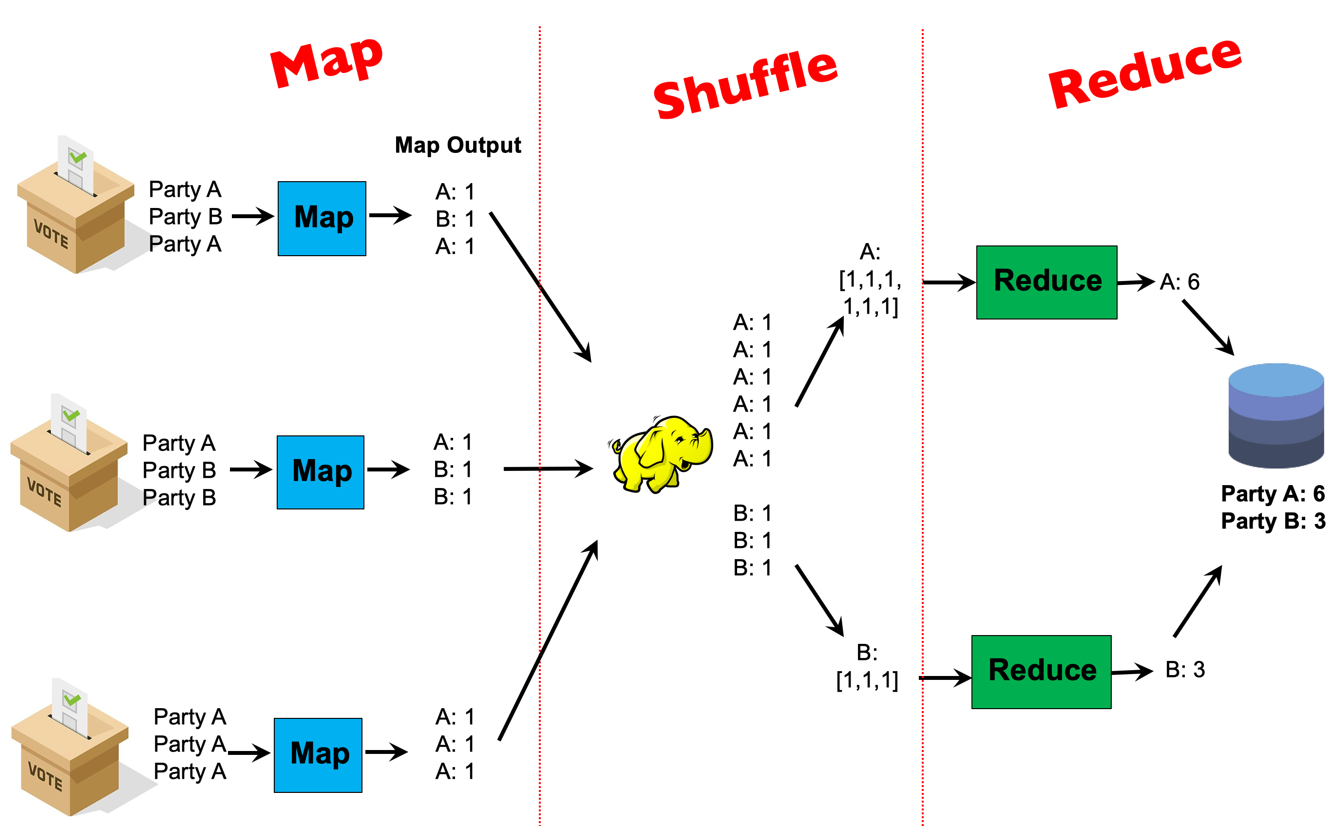
Writing MapReduce Programs
Typical Interface: Programmers specify two functions:
map (k₁, v₁) → List(k₂, v₂)
reduce (k₂, List(v₂)) → List(k₃, v₃)
All values with the same key are sent to the same reducer
Notes:
More precisely, programmers specify two functions: Map and Reduce.
the input of Map is a key and a value (key/value pair). It can output a number of key/value pairs.
The MapReduce runtime will ensure All values with the same key are sent to the same reducer.
Then, the reduce takes a key and its value list and output/emit a number of key/value pairs.
You can see that we can implement a chain of mapreduce. Since the output of the reduce is also key/value pairs.
The execution framework handles the challenging issues else…
How do we assign work units to workers?
What if we have more work units than workers?
What if workers need to share partial results?
How do we aggregate partial results?
How do we know all the workers have finished?
What if workers die/fail?
☺☺
We will cover some details of those aspects later.

Slide 53
Writing MapReduce Programs
Typical Interface: Programmers specify two functions:
map (k₁, v₁) → List(k₂, v₂)
reduce (k₂, List(v₂)) → List(k₃, v₃)
All values with the same key are sent to the same reducer
The execution framework handles many challenging issues…
How do we assign work units to workers?
What if we have more work units than workers?
What if workers need to share partial results?
How do we aggregate partial results?
How do we know all the workers have finished?
What if workers die/fail?
Notes:
More precisely, programmers specify two functions: Map and Reduce.
the input of Map is a key and a value (key/value pair). It can output a number of key/value pairs.
The MapReduce runtime will ensure All values with the same key are sent to the same reducer.
Then, the reduce takes a key and its value list and output/emit a number of key/value pairs.
You can see that we can implement a chain of mapreduce. Since the output of the reduce is also key/value pairs.
The execution framework handles the challenging issues else…
How do we assign work units to workers?
What if we have more work units than workers?
What if workers need to share partial results?
How do we aggregate partial results?
How do we know all the workers have finished?
What if workers die/fail?
☺☺
We will cover some details of those aspects later.

Slide 54
MapReduce Execution Framework
Handles scheduling
Assigns workers to map and reduce tasks
Handles “data distribution”
Moves processes to data
Handles synchronization
Gathers, sorts, and shuffles intermediate data
Handles errors and faults
Detects worker failures and restarts
Everything happens on top of a distributed file system (later)
Notes:
in this lecture, we briefly talk about how MapReduce runtime addresses the complexity of those issues we discussed in the beginning of the lecture.
More details can be found from the research article by Jeff Dean.
Handles scheduling
Assigns workers to map and reduce tasks //there are many advanced scheduling algorithms for efficiency. You can google.
Handles “data distribution”
Moves processes to data //the cost of moving data is high on data center.
Handles synchronization
Gathers, sorts, and shuffles intermediate data //although it can be costly, it is a general pattern for many applications! Also, there are many other studies to optimize the performance of shuffling and sort.
Handles errors and faults
Detects worker failures and restarts //a lightweight detection. See the paper.
Everything happens on top of a distributed FS (later)

